Slide 1
Integrating Kinetic with Bartender REST API
Simon Hall
ERP Support Specialist
May 22, 2024

Slide 2
Speaker Biography
Working with Epicor Products since 1998, a seasoned professional with a rich background in various Small to Medium Enterprises, specializing in Customer Support, OS, Network, Database Administration, and ERP Implementation. My recent role has been on ERP Technical Support at Polyaire Australia. My expertise extends to ERP data migrations, administering Epicor ERP on Azure IaaS, developing third-party integrations using Epicor technologies including Functions and the Epicor REST API.
Simon Hall
ERP Support Specialist Polyaire Pty Ltd

Slide 3

Simon Hall Polyaire Australia
Involved with Epicor Products since 1998
Worked in various industries, Distribution, Professional Services, Manufacture supporting Epicor Products and developing customizations
Dual experience from a Vendor and customers perspectives.
A VW Vanagon tragic….
28
2017
30/250
2022.1
101
At Polyaire, we are committed to excellence in air conditioning systems and solutions. Our philosophy centres on innovation, quality, and customer satisfaction. We strive to provide cutting-edge products and services that enhance comfort and efficiency. Our vision is to lead the industry through sustainable practices and continuous improvement, ensuring the highest standards of performance and reliability for our clients.
AMM, Phocas
FastClose
Automation Studio
Bartender Enterprise

Slide 4

Overview
Different methods of Generating Bartender Labels in Kinetic
Standard Kinetic Bartender Functionality
On Demand Labels for non-Bartender enabled Reports. The old way
REST Integration using Bartender REST API and Integration Webservices
Notes:
I am not a Bartender Expert, and throughout me preparing this talk, it appears that I am walking in the footsteps of Giants who have already tackled their own problems using the Bartender in all its different guises.
To those people I tip my hat to you.
I highly recommend you check out the various posts on EpiUsers, there are quite a few, including some great code examples….
Today we are going to cover the following – READ SLIDE Today, we are going to cover the different methods of creating labels, overview the Standard functionality, cover the old way we typically create a label, and finally we will take a deeper dive into using Bartender Integration Web Ser ice and Bartender REST API methods of creating a label

Slide 5
What is Bartender?
Software for designing and printing labels, barcodes, RFID tags, and more.
Used by businesses of all sizes to improve efficiency, accuracy, and compliance in labeling and identification processes.
Bartender offers a range of features, including an easy-to-use design tool, database connectivity, and automation capabilities, making it a powerful solution for managing labeling and identification needs.
Notes:
My first ever exposure to Bartender I was asked to go out to a client site and install this software called Bartender.
I was ignorant at the time and could not understand why I was going out to a customer who wholesale stationary supplier to install software name Bartender…. Did they have some Employee Bar in the back of the warehouse? Sadly I spent the afternoon with a CD ROM installing software on a sever setup rack in a freezing breezeway in the warehouse.
Boy was I wrong….. I laugh about it now.
If you are not aware Seagull Scientific also has a SaaS version of Bartender Automation, which may make integrating Bartender for Epicor Cloud customers somewhat easier, particularly using REST… No more FTP or SFTP…..
Additional Points Only works with the Automation and Enterprise Editions of Bartender.
Automation Edition - History Explorer 7 days of Data to a local db , Print Portal - Supports web-based printing only, Reprint Console - The Enterprise Edition supports reprints with no restrictions; The Automation Edition supports unlimited reprinting of documents from the logged print jobs.

Slide 6
Standard Kinetic Bartender Report Process 5 steps
Label Printed
Trigger Trans
Update
Auto Print Data Directive Executed
Report File Generated & Stored
Bartender Integration Processes file
We trigger an update (Std Data Directive) on
PartTran
JobMtl
RMAHead
OrderHead
ShipHead
RcvDtl
PkgControlHeader
Call AutoPrint based on specific condition to execute a specified report style
GenInv
GenJob
GenQA
GenSO
GenShip
GenRcpt
GenPCID
Output of the executed Report Style and Data Definition. Using stored parameters for:
Report Location (Bartender Template)
Output Location
Preconfigured Bartender File Integration polls the configured path output location from the report style and processes the generated file.
Success!
Notes:
Epicor can be integrated right out of the box or programmatically. I am going to give take you through different ways we can print labels.
First up is the inbuilt functionality in Epicor…..

Slide 7
Kinetic Bartender – uBAQ/Func – Other Reports 4 Steps
Label Printed
Trigger Data/Method Directive or UI Code
Execute an Updatable BAQ
Bartender Integration Processes file
We get to decide how, what and when to print a label
Updatable BAQ generates a file with specific Bartender command syntax and data, or call an Epicor Function
User codes could be used for specific parameters e.g. Template file, Pickup folder, filename
Preconfigured Bartender File Integration polls the configured path from the report style and processes the generated file.
Success!
Notes:
Another option is to use an Updatable BAQ and generate the data and print the label in one, or calling a generic function to perform all the label printing functionality. The uBAQ can be called from a Dashboard or custom code
If we want to help genericize the uBAQ code then using User codes can help in giving you the ability to update related data (label file names, directory locations etc).

Slide 8
Kinetic Bartender Web Svc - Function Method – Other Reports 4 Steps
Label Printed
Trigger Data/Method Directive or UI Code
Execute an Epicor Function
Bartender Integration Web Service
We get to decide how, what and when to print a label
Generic Function called with specific parameters to call a BAQ generate data Generate a REST Request to Bartender Web Service Integration
User codes used for specific parameters e.g. Template file, Pickup folder, filename
Preconfigured Bartender Web Service is executed with the request data.
Success!
Notes:
Or we can execute an Epicor function that calls a Bartender Integration that is configured as a web service (either using a GET request or a POST request).
*Remember if you are using the GET request the data for the label need to be passed as request parameters. URL has a limited number of characters available. You could feasibly to this with a uBAQ also, although I have never attempted this.

Slide 9
Kinetic Bartender REST API- Function Method – Other Reports 3 Steps
Label Printed
Trigger Data/Method Directive, UI Code or Externally
Execute an Epicor Function
We get to decide how, what and when to print a label
Generic Function called with specific parameters to call a BAQ generate data Generate a REST Request to Bartender REST API
User codes used for specific parameters e.g. Template file, Pickup folder, filename
Success!
Notes:
Or we can execute an Epicor Function that calls the Bartender REST API.
Ultimately how you implement your label printing solution is up to you, but I encourage consistency..

Slide 10

Snoozefest Alert ! - REST API Basics
Notes:
“Good news, folks! We’re on a tight schedule, so I’ve axed a few slides. An intro to REST is out! So Brace yourselves for a snappy, snooze-festless (hopefully) adventure through our topic today!
For those new to Representational State Transfer APIs, I encourage you to explore Roy Fielding’s work to grasp the fundamentals of REST, and the REST of REST.
There’s a wealth of information available across the web on EpiUsers

Slide 11
Bartender Integration (WebSvc) REST API Vs BT REST API
Bartender Integration REST API
Introduced in Bartender 2016
Each Web Service Integration is its own unique endpoint (URL) based on its name.
GET Integrations allow only a 1 label per request. Variables in Request URL
POST Integrations allow multiple labels per request. Variables in Body of Request (using csv)
Bartender REST API (Actions)
Introduced in Bartender 2022. Gives another way to print documents without using an integration.
Can use BTXML, YAML or JSON
Print Actions
Input Actions
Output Action
Execute Actions
File Actions
Transform Actions
Database Actions
Refer Bartender REST API Overview
Notes:
How can we use REST with Bartender? What do we know? There are two different APIs that Bartender provide (well there’s more, but we are only interested in the current form), up until Bartender 2022 the only way you could stand up a REST API resource for Bartender was to use a Webservice Integration.
Now you can use a complete REST API that can replicate anything you can put into a Bartender integration but, do it with code.
…. There are Pros and cons for each method. We will talk a little bit about them now.
The Bartender REST API has comprehensive online documentation that you can tale advantage of to really make your labels sing (Cue Kevin)

Slide 12
Pros and Cons Bartender Integration (Web Service)
Pros
You have control of the resource id/URL via the integration name
Integration processing shows in Bartender Admin for monitoring.
A simple low code tool for creating complex integrations
No file generation needed
Cons
Adds a layer of complexity to the solution that may not be needed
Can only follow workflow built into the Integration
GET Method 1 label
POST Method 1 to many labels (using CSV)
Limited number of characters can only be passed in the URL (GET)
Notes:
What are the Pros and cons of the using a Bartender Integration as a Web Service?
When using the GET Method the data needs to be passed as request parameters (i.e. in the URL). The POST method requires the data to be passed in the request body.
Integrations don’t read JSON Array.

Slide 13
Pros and Cons Bartender REST API
Pros
No intermediary process needed
No file generation needed
One Resource/URL for all print jobs
Can dynamically modify workflow by using other API commands in your request payload
Use Action Groups to print multiple labels
Cons
Have to roll your own monitoring solution unless you want to use History Explorer
Relatively New.
Need to use Reprint Console or bespoke reprint method to reprint labels.
Notes:
Like the Bartender Integration Web service, the Bartender REST API has its own Pros and Cons and there is some overlap.

Slide 14
The Problem

Slide 15
The Problem
Existing Legacy Requirements Needed a Bespoke Solution:
Current solution was batch solution executing every 5 minutes regardless if there was anything to print. Wanted to move to a more immediate label print scenario.
Needed to be able to Reprint Labels without having to leave the Kinetic UI
Needed to be able to Reprint Labels without having to install additional software
Improve label print reliability. Generating files across the network was unreliable.
Why not use the GenJob Report style?…….The RDD did not provide the flexibility for the data needed in the specific label
Notes:
Our current solution was originally put in place to as a short-term resolution to resolve a performance problem before go live.
Like all stop gaps they always last longer than they should.
Not constrained by the RDD

Slide 16
The Solution
Notes:
For a long time, I have thought to resolve our problem by looking at the utilizing the Integration Web service, and when I finally did go down that path, I discovered the Bartender REST API had been released. So, I now had two ways to produce a solution.
In my journey, what we ended up producing was an Epicor Function, that will can be used for both Bartender Integration web services and the Bartender REST API, with minimal effort. with a flexible, simple reusable procedure.
For the most part it the only thing you need to do now is
Design the label
Configure the BAQ
And call the function from wherever the label print needs to be printed.
So, without further ado, I am going quickly to run through the process of creating the Web service integration, and the Epicor function.

Slide 17
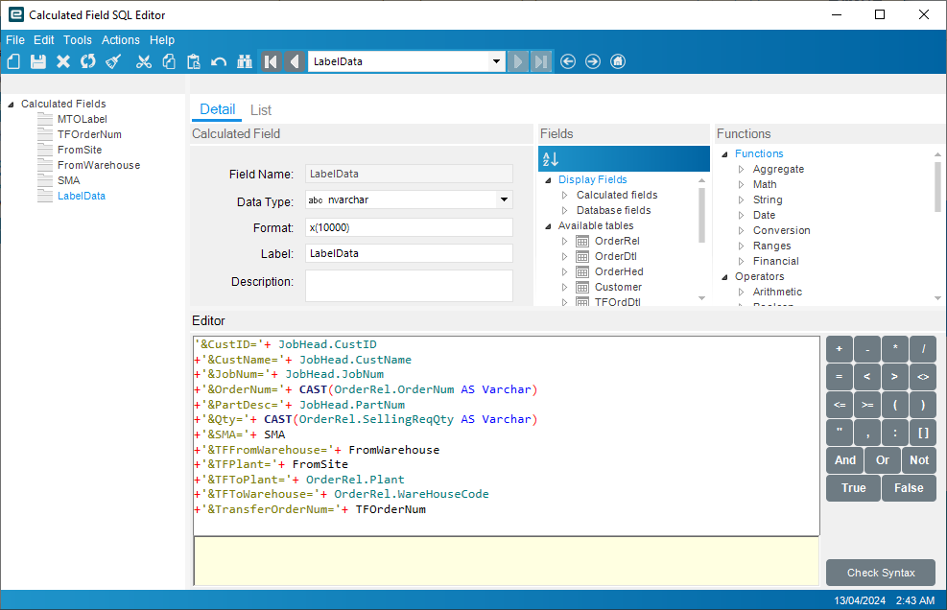
Create Your BAQ
Various ways
We create a BAQ with a Calculated Field concatenating the Named Data Sources For a GET Method
OR
We serialize the column names from BAQ Results dataset into JSON – Put in Body (POST Method)
Notes:
First off we create a BAQ with the required data for the label and any parameters you would require
In this example we are cramming all the data into one field so we can use a GET Request…… You don’t have to do it this way, this is just one of my first attempts.

Slide 18
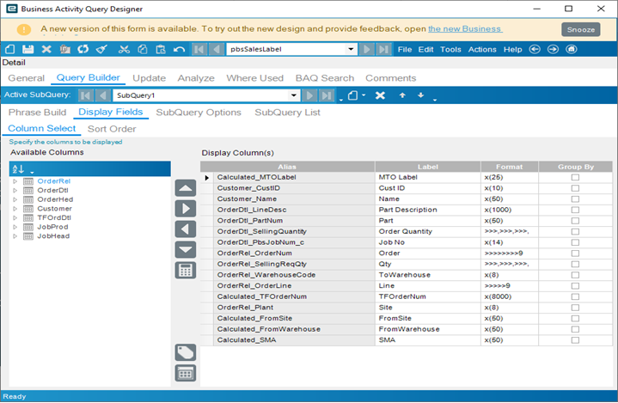
Create Your BAQ
Various ways
We create a BAQ with a Calculated Field concatenating the Named Data Sources For a GET type Integration
OR
We manipulate the column names from BAQ in the Function into JSON
Notes:
Take note of the Aliases for the display fields, as they will become the Named Data Sources when you create the label.

Slide 19
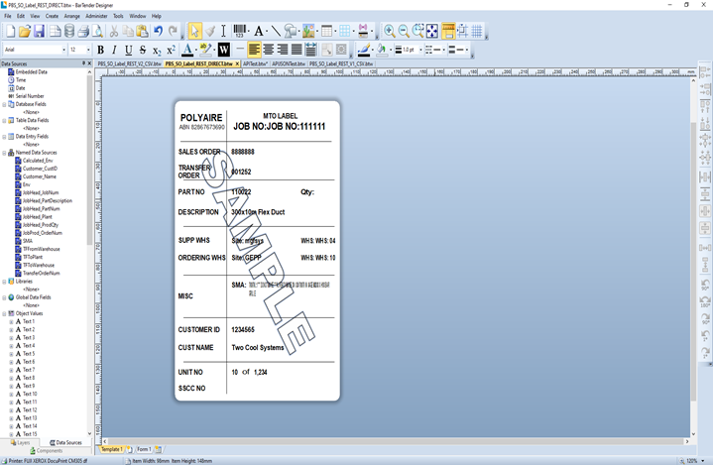
Create Bartender Label
Use Named Data Sources rather than database fields
Add in any other smarts to the label you need (numbering, watermarks etc.)
Notes:
Now we open Bartender Designer and build create a label.
We use named data sources rather than a database fields as you would have done if you were using the standard Epicor label printing method.
The best way I have found is just export the results the of the Display field grid to excel then use that as the basis for creating your Named Data Sources. They need to be named the same as the Alias column names in the BAQ
For example, Calculated_Env or Customer_CustID

Slide 20
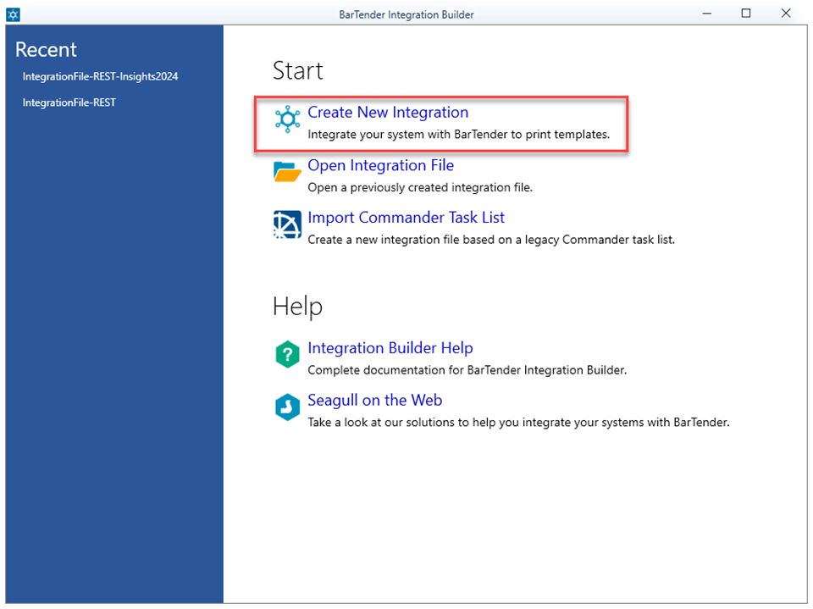
Create Bartender Integration
Create New Integration
Notes:
If using the Web service Integration method we use the following steps to build a web service integration

Slide 21
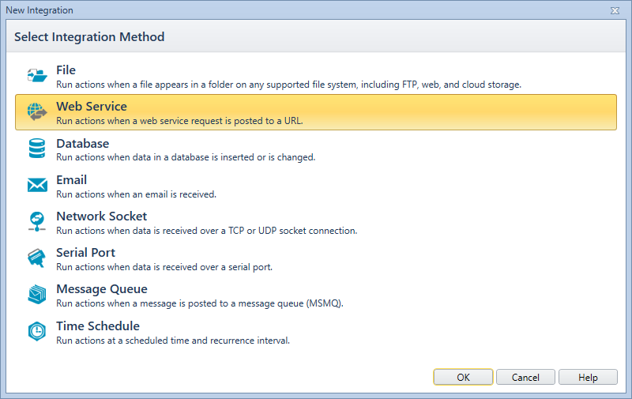
Create Bartender Integration
Create New Integration
Select Web Service

Slide 22
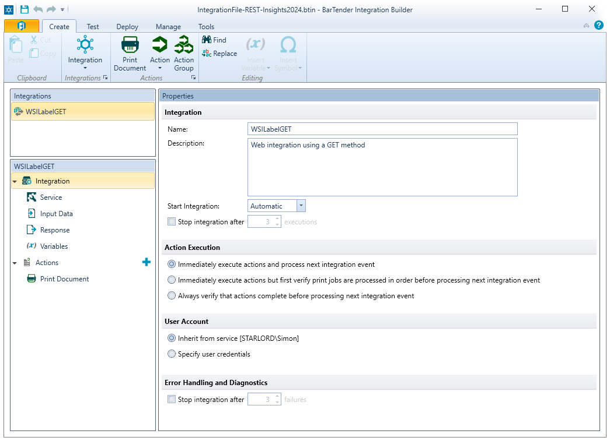
Create Bartender Integration
Create New Integration
Select Web Service
Name the Integration
Notes:
The integration name becomes part of the url for the web request

Slide 23
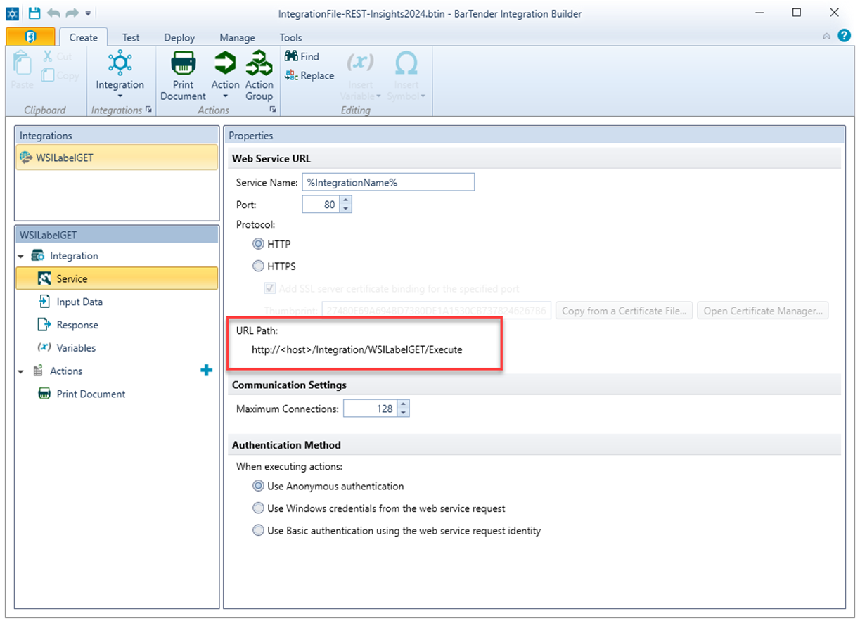
Create Bartender Integration
Create New Integration
Select Web Service
Name the Integration
Configure the Service and Security

Slide 24
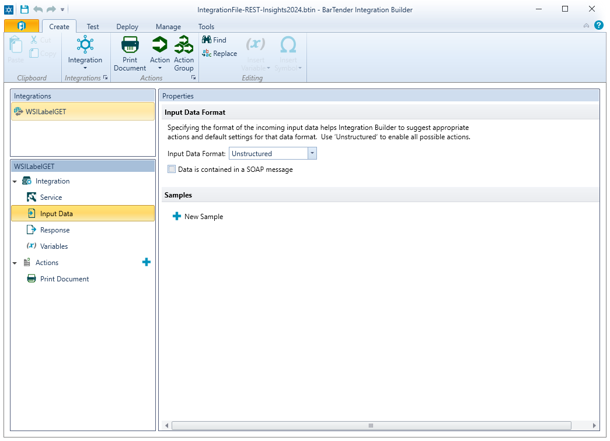
Create Bartender Integration
Create New Integration
Select Web Service
Name the Integration
Configure the Service and Security
Select Input Data Format

Slide 25
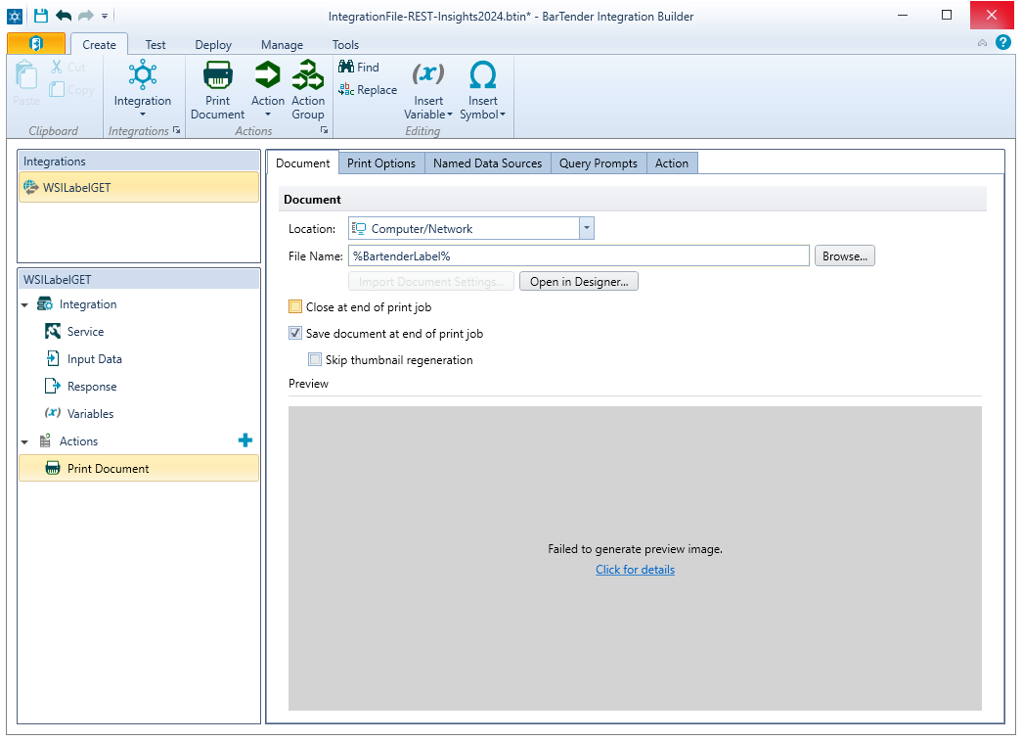
Create Bartender Integration
Create New Integration
Select Web Service
Name the Integration
Configure the Service and Security
Select Input Data Format
Configure Document Properties and Named Data Sources
Notes:
We use the %BartenderLabel% variable as a placeholder for the incoming name of the label

Slide 26
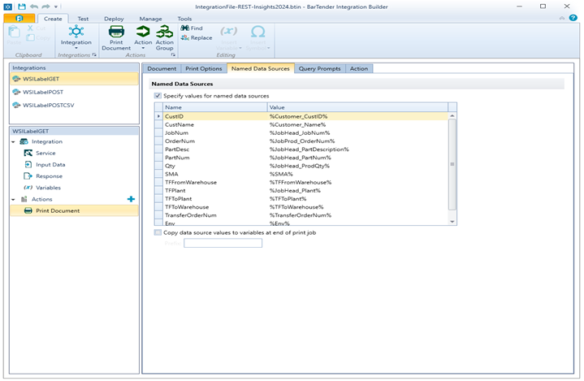
Create Bartender Integration
Create New Integration
Select Web Service
Name the Integration
Configure the Service and Security
Select Input Data Format
Configure Document Properties and Named Data Sources
Notes:
We map all the field names By Encoding the Value with the % signs around the data source name in the label

Slide 27
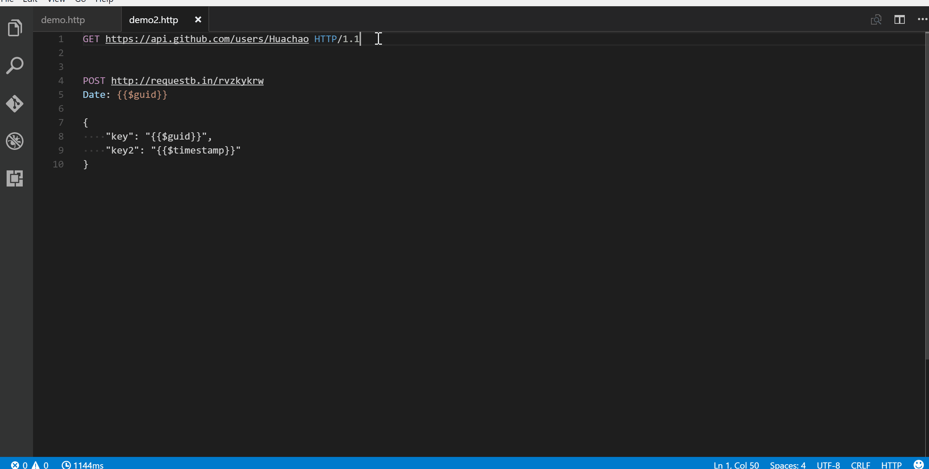
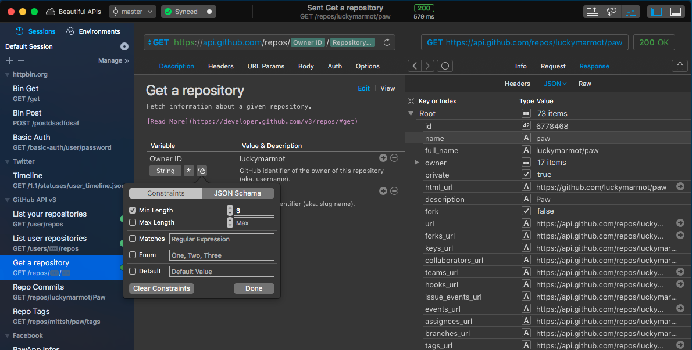
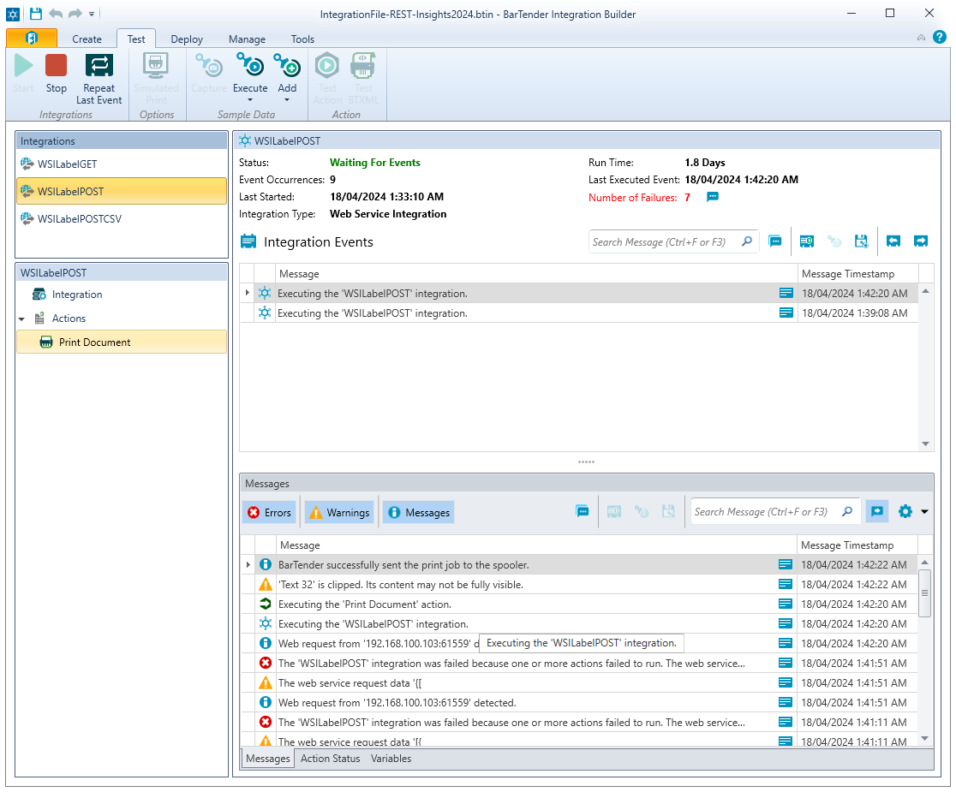
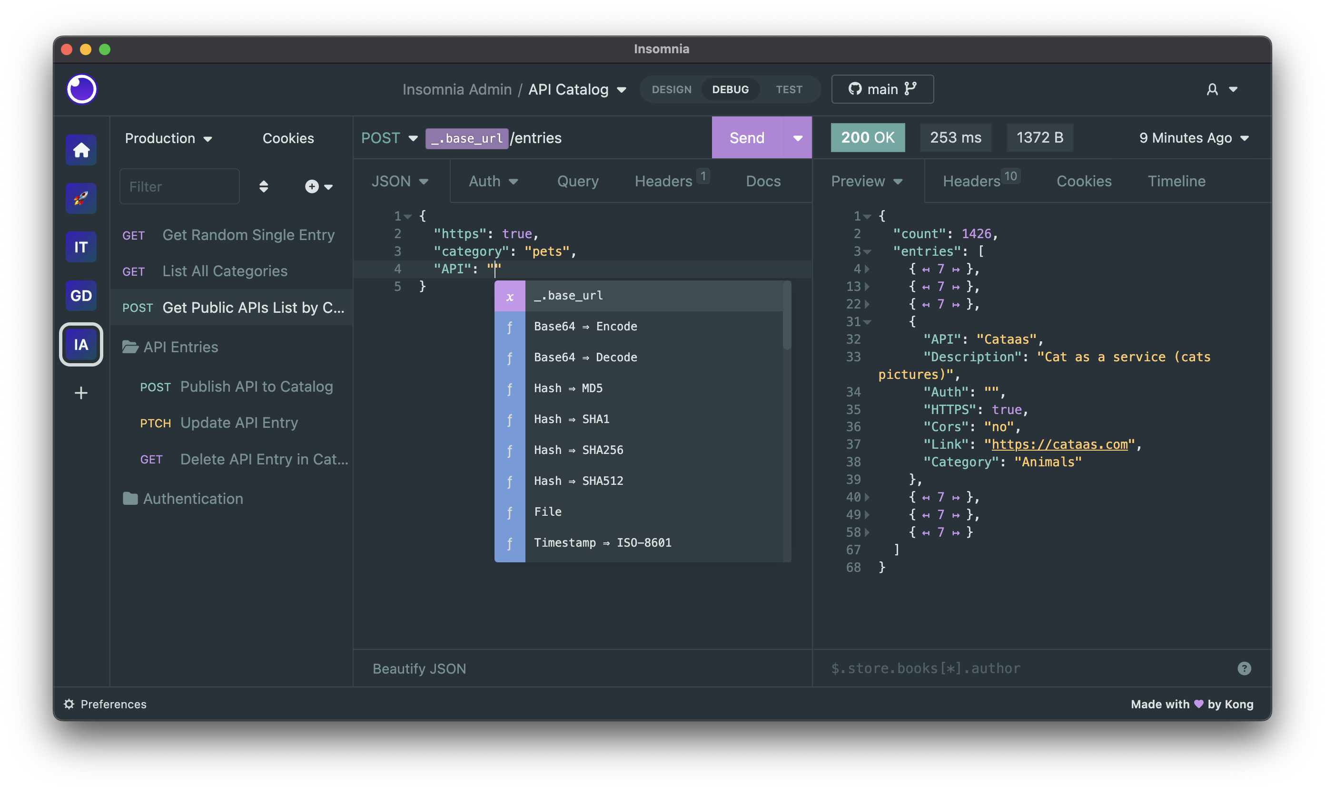
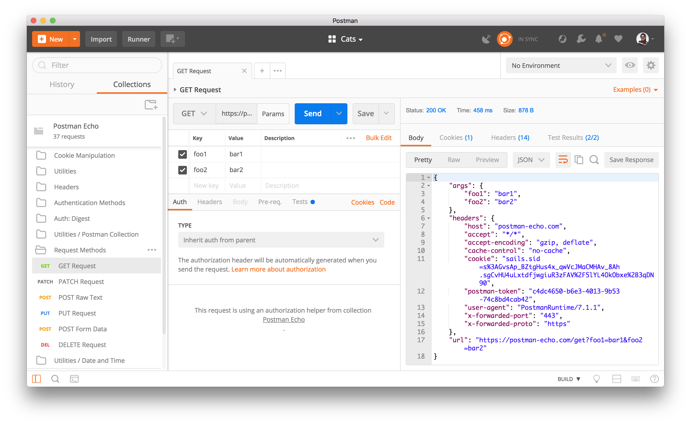
Test Bartender Integration
Enable Test Mode in your integration
Use your favourite REST Testing tool
Notes:
We can now test the integration. Go to the test tab and click on play. All things being setup correctly the integration should start listening for requests to process.

Slide 28
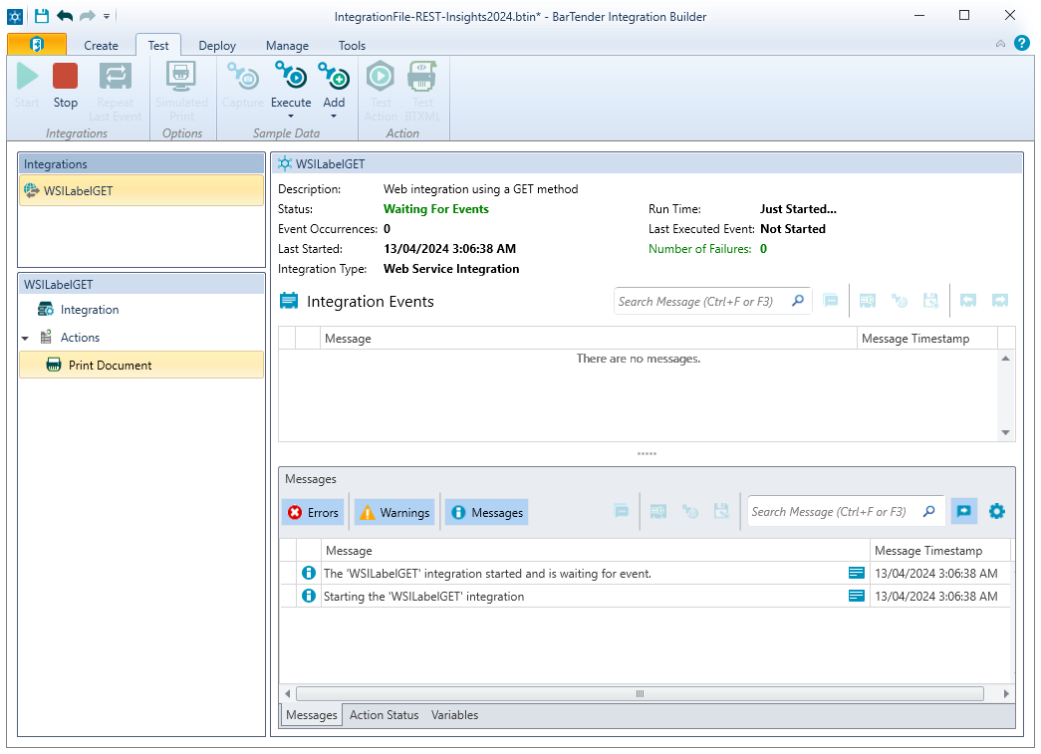
Test Bartender Integration
Enable Test Mode in your integration
Use your favourite REST Testing tool
Rapid API

Slide 29
Test Bartender Integration
Enable Test Mode in your integration
Use your favourite REST Testing tool
Rapid API, Insomnia

Slide 30
Test Bartender Integration
Enable Test Mode in your integration
Use your favourite REST Testing tool
Rapid API, Insomnia, Postman,

Slide 31
Test Bartender Integration
Enable Test Mode in your integration
Use your favourite REST Testing tool
Rapid API, Insomnia, Postman, VSCode

Slide 32
Common Problems

Slide 33
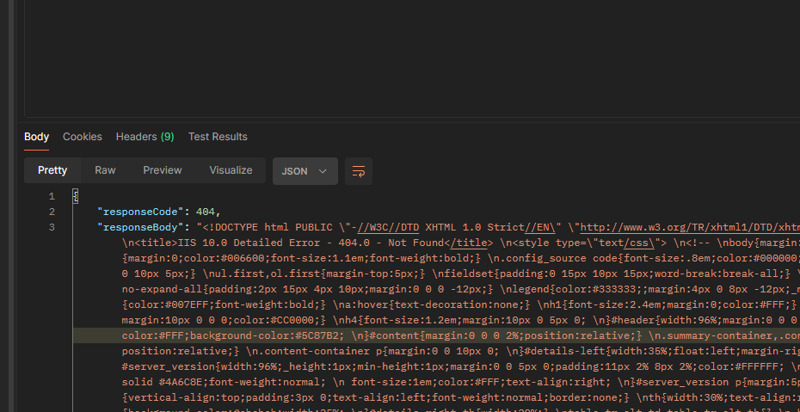
Common Problems
404 Error
Notes:
404 errors mean that you have forgotten to enable your integration for testing or deploy it.
For the Bartender REST API. Your Print portal website is down for some reason.

Slide 34
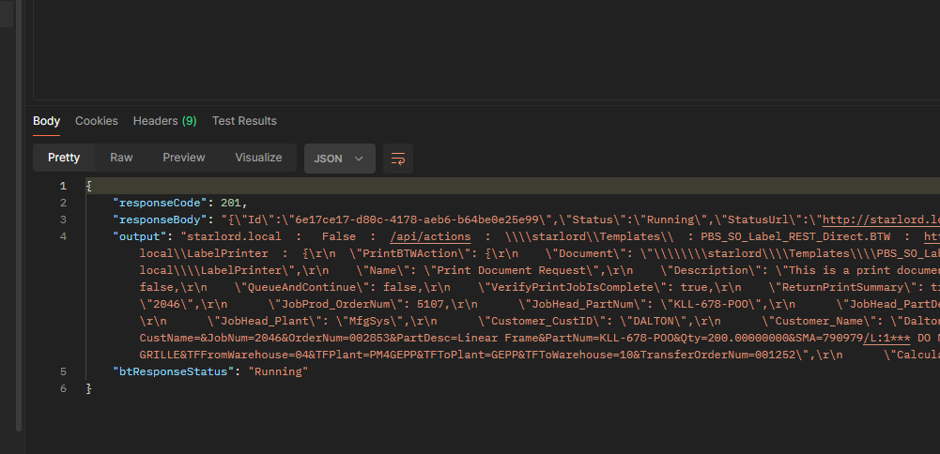
Common Problems
404 Error
Expecting a 200 Ok when Bartender returns a 201 Created
Notes:
With the Bartender REST API you will get a status code of 201 when a request is complete You need to parse the results to find out exactly how the Bartender REST API responded. Review the response body to determine this. The value of Status field will indicate the progress off the job, a Status URL is also provided and a subsequent REST request to that URL would yield more information. Note that this information by default only exists for 60 minutes.
The Bartender REST API overview provides the list of all status codes.
When using the Integration Web service. It will always return a status code of 200 even if the print succeeds or not. The information in the response body will indicate the true state of the print job in this instance the Status and Wait Status values will be the ones to observe they will have values such as Ran to Completion and Completed for successful prints and Faulted for failed jobs

Slide 35
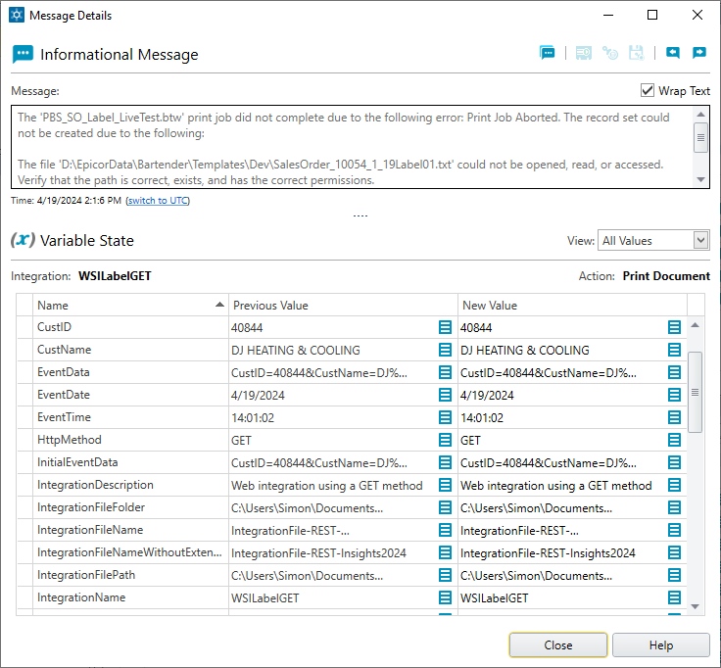
Common Problems
404 Error
Expecting a 200 Ok when Bartender returns a 201 Created
File Could not be opened, read or accessed
Notes:
This is a good example if for some reason the label has a file Database fields still included in the template…You need to convert it over to using Named Data Sources.

Slide 36
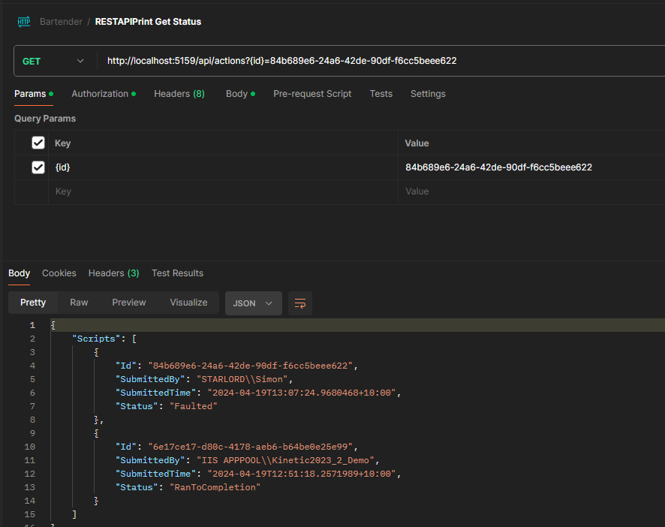
Common Problems
404 Error
Expecting a 200 Ok when Bartender returns a 201 Created
File Could not be opened, read or accessed
No Label being printed. (Using REST API)
Notes:
Example of the Response when querying the REST API output from the attempted label generation. Notice the two logged items.
You can also see detailed information in the Bartender System Database MessageStrings Table.
As previously mentioned this information only exists for 60 minutes unless otherwise configured in the web.config of the Print Portal
Using and Integration Web Service you would see this int execution log.

Slide 37
Create Your Function Both methods
Create for Using BT Integrations
Or
Bartender REST API
Notes:
So now we are at the point of creating the function. As we all know we can call functions from many different parts of Epicor, so we won’t cover that today.
Depending on how you implement it will determine the request data format.
-Integration Web Services using a GET request – need to pass in the data via the URL as query parameters
-Integration Web Services using a POST request – needs to use JSON key pair values in the request body.
Bartender REST API will use a POST request – needs to have json formatted as an ACTION with the json key pair values and the data in a nested DataSourceName key.
In order to print multiple labels per request also varies
- For Integration GET Requests there is no option just one label per request
- For Integration POST Requests you need to have an integration that processes the data in the form of delimited list of values, parse it out to file then process the file.
- For Bartender REST API Requests you need to form your data with an ACTION GROUP node book ending each print action under that.

Slide 38
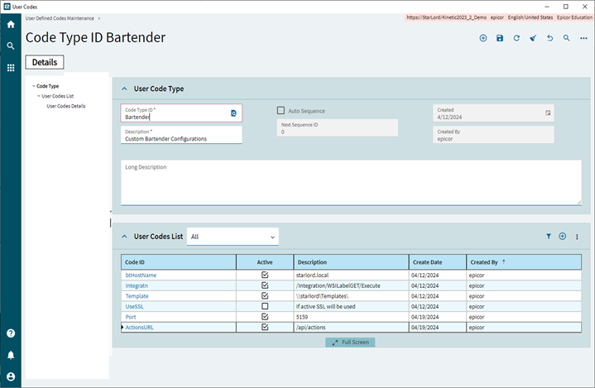
Create Your Function Both Methods
Configure System variables as User Codes
Notes:
You can use User codes to predefine variable that then are easily maintainable rather than having to hard code things. This is just one example. There is no reason you could not have user codes configured on a per label basis to aid in any future maintenance requirements, having all that information in one location aids in maintenance of the overall solution.

Slide 39
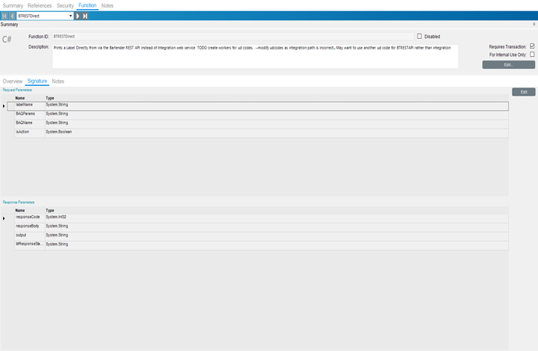
Create Your Function Both Methods
Configure System variables as User Codes
Configure your signatures

Slide 40
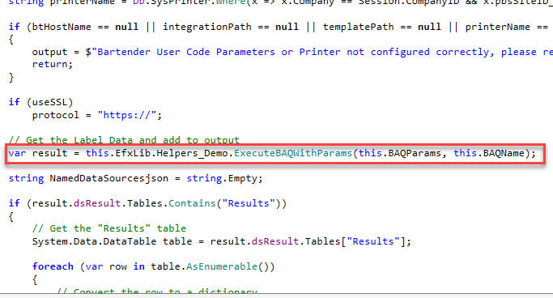
Create Your Function
Configure System variables as User Codes
Configure your signatures
Call the BAQ (or Not)
Notes:
Call your BAQ swiss army knife function here. Of course, if your label requirements are fairly simple for example your label already has all the embedded data in it you don’t need to do this.

Slide 41
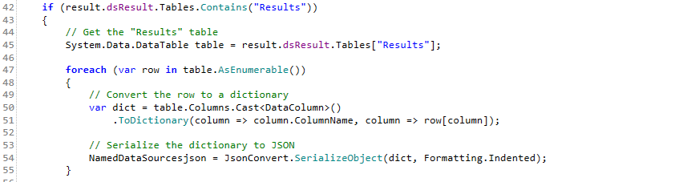
Create Your Function
Configure System variables as User Codes
Configure your signatures
Call the BAQ (or Not)
Manipulate BAQ Output
Notes:
If you are calling the data from the BAQ and you are going to use the Bartender REST API you will need to serialize it so it can be embedded in the full JSON data
If using the Integration Webservice in a POST format. Then you need to generate the JSON as a KeyPair format. No JSON Arrays.

Slide 42
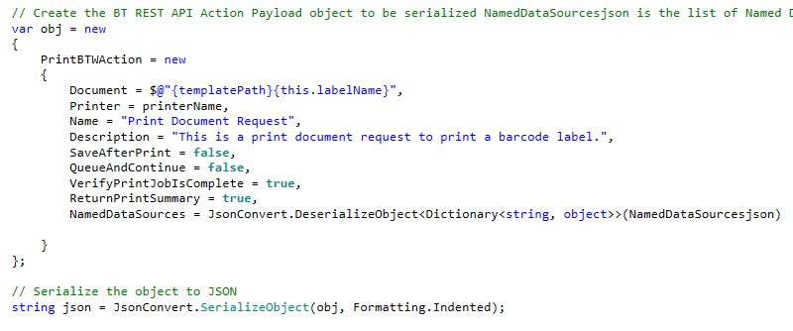
Create Your Function
Configure System variables as User Codes
Configure your signatures
Call the BAQ (or Not)
Manipulate BAQ Output
Notes:
Notice we now add the NamedDataSources data to the main JSON object

Slide 43
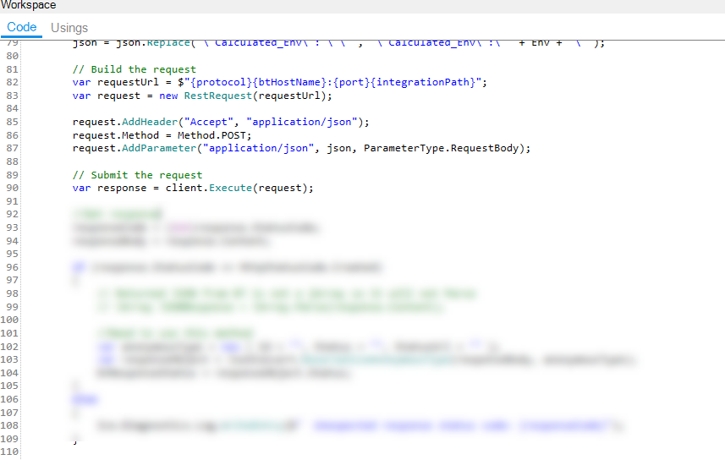
Create Your Function
Configure System variables as User Codes
Configure your signatures
Call the BAQ (or Not)
Manipulate BAQ Output
Create and Send the REST Request
Notes:
We then send the request.

Slide 44
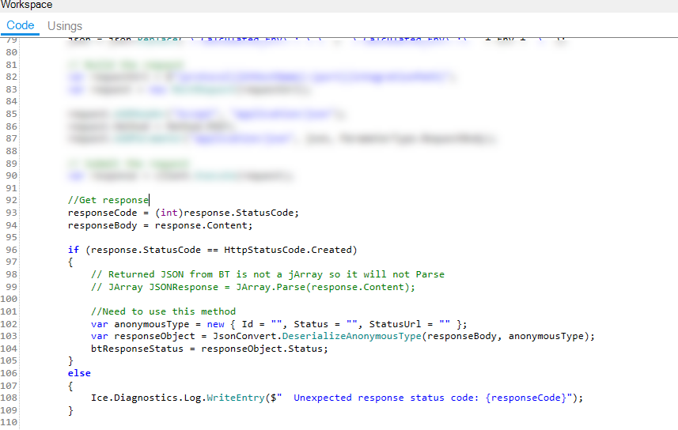
Create Your Function
Configure System variables as User Codes
Configure your signatures
Call the BAQ (or Not)
Manipulate BAQ Output
Create and Send the REST Request
Analyse the Response and respond accordingly
Notes:
And we act accordingly on the response.

Slide 45
Test Your Function
Configure your test tool to use the “staging URL” if you are not going to publish.
Use your favourite REST Testing tool
Rapid API, Insomnia, Postman, VSCode
Notes:
Of course, we can then call the Epicor function using your favorite tool to test it out.
My suggestion here is just redirect the printer you are using to another print and pause it. That causes Bartender to think it printed when it hasn’t
I think that wraps it up.
Sample code will be uploaded to Epicusers after Insights.

Slide 46
The Takeaway
Integration Webservice REST API = Build an Integration
Bartender REST API = No Integration Needed

Slide 48
Resources
Epicare Bartender Knowledge Articles - KB0041613
BARTENDER - information on setting up autoprint BPMs needed to print standard ERP Bartender labels - KB0041613
EpiUsers REST Overview – Novel
Epicor Help - Search Overview of REST API v.2
Automating Bartender
Bartender REST API Overview
Bartender Print Portal REST API
Bartender Cloud REST API
Bartender REST API Actions YAML Reference
Seagull Software Support Knowledgebase
Tools
Swagger
Postman
VS Code REST Extension
Insomnia
Rapid API
Creating a Secure Web Integration
Integraton Troubleshooting Guide

Slide 49


